Slide 1
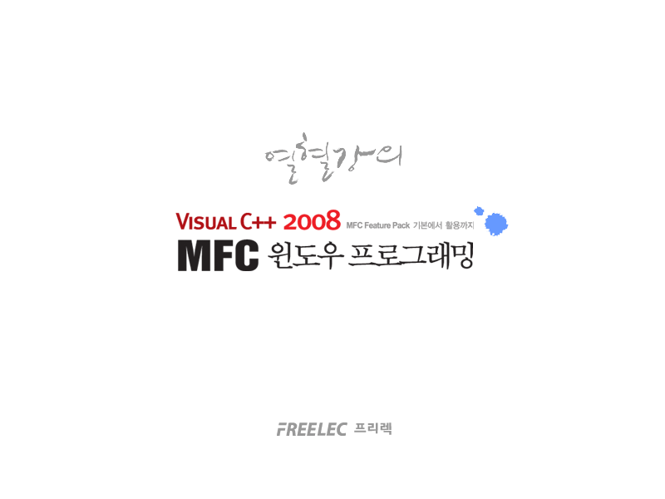

Slide 2
Part 5
  Windows system programming

Slide 3
Chapter 28
  System programming basic

Slide 4
Call convesion
#elif (_MSC_VER >= 800) || defined(_STDCALL_SUPPORTED)
#define CALLBACK __stdcall
#define WINAPI __stdcall
#define WINAPIV __cdecl
#define APIENTRY WINAPI
#define APIPRIVATE __stdcall
#define PASCAL __stdcall

Slide 5
Call convesion - __cdecl
175
176 void __cdecl AddValue(int nA, int nB, int* pnResult)
177 {
178 *pnResult = nA + nB;
179 }
180
181 void CCallConventionDlg::OnButtoncdecl( )
182 {
183 int nResult = 0;
184
185 AddValue(10, 20, &nResult);
186 }
187

Slide 6
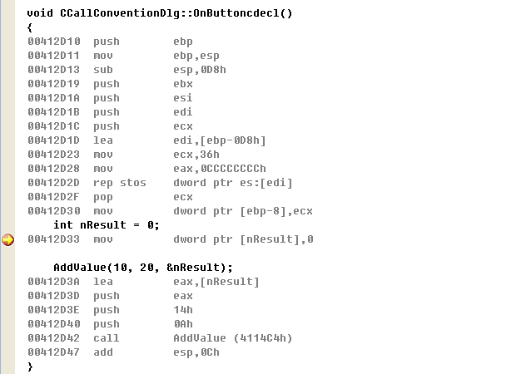
Call convesion - __cdecl

Slide 7
Call convesion - __stdcall
188
189 int __stdcall AddValue2(int nA, int nB)
190 {
191 return nA + nB;
192 }
193
194 void CCallConventionDlg::OnButtonstdcall( )
195 {
196 int nResult = 0;
197 AddValue2(10, 20);
198 }
199

Slide 8
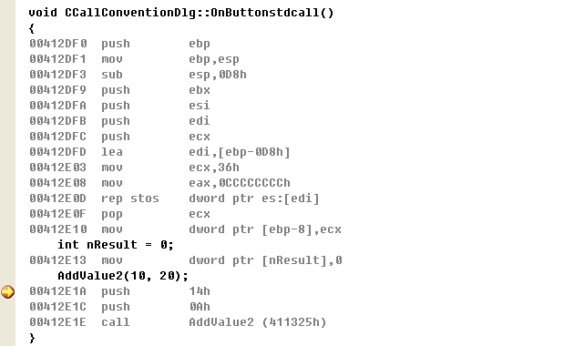
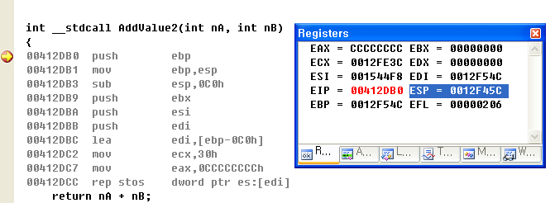
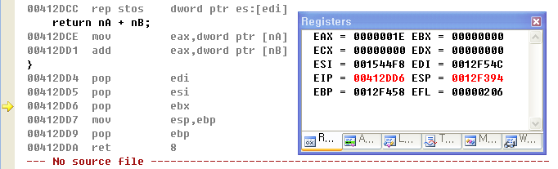
Call convesion - __stdcall

Slide 9
Call convesion - __fastcall
199
200 int __fastcall AddValue3(int nA, int nB, int nC, int nD)
201 {
202 return nA + nB + nC + nD;
203 }
204
205 void CCallConventionDlg::OnButtonfastcall( )
206 {
207 int nResult = 0;
208 nResult = AddValue3(1, 2, 3, 4);
209 }
210

Slide 10
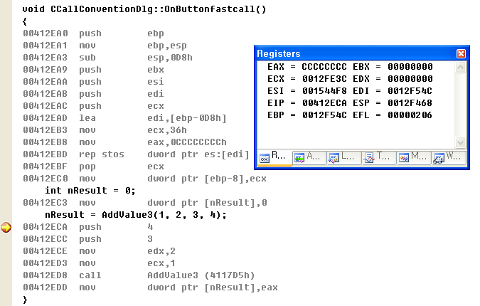
Call convesion - __fastcall

Slide 11

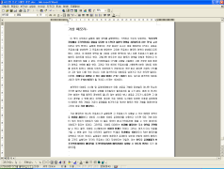
Virtual memory
0x00000000
0xFFFFFFFF
Internet explorer
process
1
2
4GB (VMS)Virtual Memory Space
User mode memory
Kernel mode memory
RAM
HDD
512MB
80GB
0x00000000
0xFFFFFFFF
MS Word
4GB (VMS)Virtual Memory Space
3
4
User mode memory
Kernel mode memory

Slide 12
Multi-bytes character sets & Unicode
Multi-bytes character sets
“String”
S
t
r
i
n
g
\0
1 byte
“문자열”
문
자
열
\0
2 byte
Unicode character sets
“String”
S
\0
t
\0
r
\0
i
\0
n
\0
g
\0
\0
\0
“문자열”
문
자
열
\0
\0

Slide 13
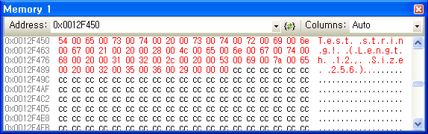
Unicode string
156
157 void CUnicodeDemoDlg::OnBnClickedButtonMessage( )
158 {
159 WCHAR wszBuffer[128];
160 wsprintf(wszBuffer, L"%s (Length %d, Size %d)",
161 L"Test string!",
162 lstrlen(L"Test string!"),
163 sizeof(wszBuffer));
164 AfxMessageBox(wszBuffer);
165 }
166

Slide 14
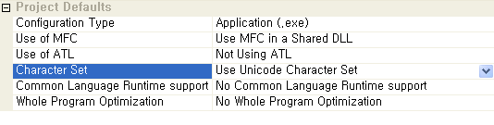
Unicode string
5708 #ifdef UNICODE
5709 #define lstrlen lstrlenW
5710 #else
5711 #define lstrlen lstrlenA
5712 #endif // !UNICODE

Slide 15
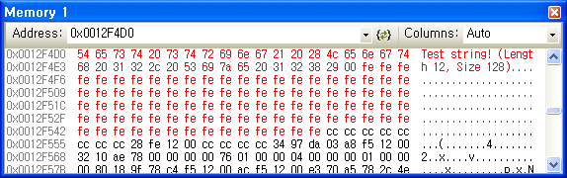
MBCS string
166
167 void CUnicodeDemoDlg::OnBnClickedButtonLength( )
168 {
169 char szBuffer[128];
170 sprintf_s(szBuffer, 128, "%s (Length %d, Size %d)",
171 "Test string!",
172 lstrlenA("Test string!"),
173 sizeof(szBuffer));
174 MessageBoxA(m_hWnd, szBuffer, "Test", MB_OK);
175 }
176

Slide 16
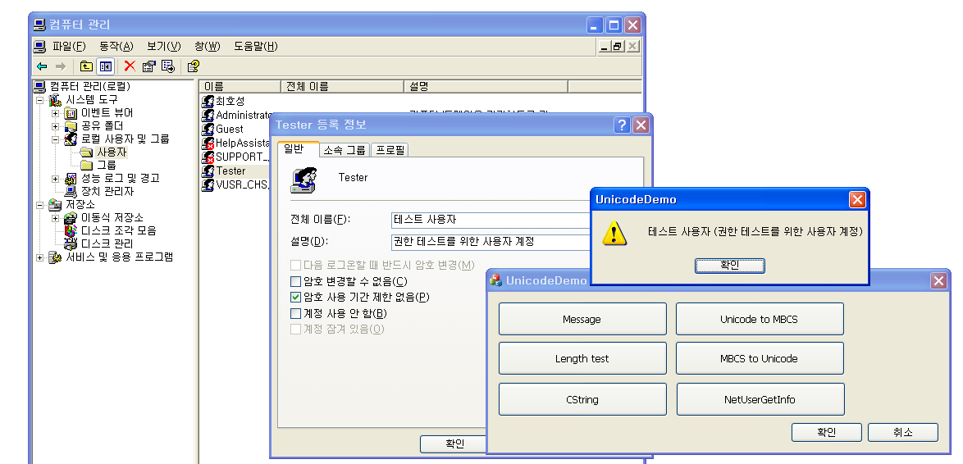
MBCS string
215
216 void CUnicodeDemoDlg::OnBnClickedButtonNetusergetinfo( )
217 {
218 CString strTmp = _T("");
219 USER_INFO_2* pUserInfo = NULL;
220 if(::NetUserGetInfo(NULL, L"Tester", 2, (LPBYTE*)&pUserInfo) == NERR_Success)
221 {
222 strTmp.Format(_T("%s (%s)"), pUserInfo->usri2_full_name,
223 pUserInfo->usri2_comment);
224 AfxMessageBox(strTmp);
225 ::NetApiBufferFree(pUserInfo);
226 }
227 }
228

Slide 17
String conversion
191
192 void CUnicodeDemoDlg::OnBnClickedButtonUnitombcs( )
193 {
194 WCHAR wszBuffer[128];
195 char szDstBuffer[128];
196 wsprintf(wszBuffer, _T("%s"), _T("Test String!"));
197 ::ZeroMemory(szDstBuffer, sizeof(szDstBuffer));
198
199 ::WideCharToMultiByte(CP_ACP, 0, wszBuffer, -1, szDstBuffer, 128, NULL, NULL);
200 ::MessageBoxA(m_hWnd, szDstBuffer, "Test", MB_OK);
201 }
202

Slide 18
String conversion
int WideCharToMultiByte(
UINT CodePage,
DWORD dwFlags,
LPCWSTR lpWideCharStr,
int cchWideChar,
LPSTR lpMultiByteStr,
int cbMultiByte,
LPCSTR lpDefaultChar,
LPBOOL lpUsedDefaultChar
);

Slide 19
String conversion
202
203 void CUnicodeDemoDlg::OnBnClickedButtonMbcstounicode( )
204 {
205 WCHAR wszBuffer[128];
206 char szSrcBuffer[128];
207 sprintf_s(szSrcBuffer, 128, "%s", "Test String!");
208 ::ZeroMemory(wszBuffer, sizeof(wszBuffer));
209
210 ::MultiByteToWideChar(CP_ACP, 0, szSrcBuffer, lstrlenA(szSrcBuffer) + 1,
211 wszBuffer, sizeof(wszBuffer)/sizeof(wszBuffer[0]) );
212
213 AfxMessageBox(wszBuffer);
214 }
215

Slide 20
Chapter 29
  Multi-thread programming

Slide 21
WaitForSingleObject()
WINSHELLAPI BOOL WINAPI ShellExecuteEx(
LPSHELLEXECUTEINFO lpExecInfo
);
DWORD WaitForSingleObject(
HANDLE hHandle,
DWORD dwMilliseconds
);

Slide 22
WaitForSingleObject()
155 UINT ThreadWaitNotepad(LPVOID pParam)
156 {
157 TCHAR szWinPath[MAX_PATH];
158 ::GetWindowsDirectory(szWinPath, MAX_PATH);
159 lstrcat(szWinPath, _T("\\notepad.exe"));
160
161 SHELLEXECUTEINFO sei;
162 ::ZeroMemory(&sei, sizeof(sei));
163 sei.cbSize = sizeof(sei);
164 sei.hwnd = NULL;
165 sei.lpFile = szWinPath;
166 sei.nShow = SW_SHOW;
167 sei.fMask = SEE_MASK_NOCLOSEPROCESS | SEE_MASK_NO_CONSOLE;
168 sei.lpVerb = __TEXT("open");
169 sei.lpParameters = NULL;
170
171 if(::ShellExecuteEx(&sei))
172 {
173 ::WaitForSingleObject(sei.hProcess, INFINITE);
174 AfxMessageBox(_T("메모장이 종료되었습니다."));
175 }
176
177 return 0;
178 }

Slide 23
AfxBeginThread()
CWinThread* AfxBeginThread(
AFX_THREADPROC pfnThreadProc,
LPVOID pParam,
int nPriority = THREAD_PRIORITY_NORMAL,
UINT nStackSize = 0,
DWORD dwCreateFlags = 0,
LPSECURITY_ATTRIBUTES lpSecurityAttrs = NULL
);
179
180 void CWorkerThreadDemoDlg::OnBnClickedButtonRunnotepad( )
181 {
182 CWinThread* pThread = AfxBeginThread(ThreadWaitNotepad, NULL);
183 if(pThread == NULL)
184 {
185 AfxMessageBox(_T("ERROR: Failed to begin worker-thread!"));
186 }
187 }
188

Slide 24
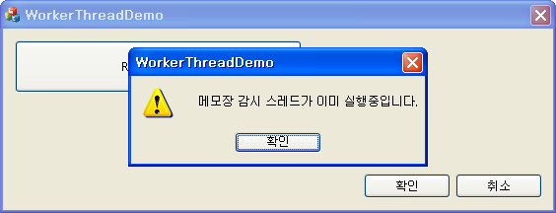
Thread object check
180
181 void CWorkerThreadDemoDlg::OnBnClickedButtonRunnotepad( )
182 {
183 if(g_pThread != NULL)
184 {
185 AfxMessageBox(_T("메모장 감시 스레드가 이미 실행중입니다."));
186 return;
187 }
188
189 g_pThread = AfxBeginThread(ThreadWaitNotepad, NULL);
190 if(g_pThread == NULL)
191 {
192 AfxMessageBox(_T("ERROR: Failed to begin worker-thread!"));
193 }
194 }
195

Slide 25
WaitForMultipleObjects()
170
171 if(::ShellExecuteEx(&sei))
172 {
173 HANDLE arhList[2];
174 arhList[0] = sei.hProcess;
175 arhList[1] = (HANDLE)g_ExitEvent;
176
177 DWORD dwResult = ::WaitForMultipleObjects(2, arhList, FALSE, INFINITE);
178 if(dwResult == WAIT_OBJECT_0)
179 {
180 AfxMessageBox(_T("메모장이 종료되었습니다."));
181 }
182 else if(dwResult == WAIT_OBJECT_0 + 1)
183 {
184 OutputDebugString(_T("WorkerThreadDemo 예제가 종료되었습니다!\n"));
185 }
186 }
187
188 g_pThread = NULL;
189 return 0;
190 }
191

Slide 26
User-interface thread
CWinThread* AfxBeginThread(
CRuntimeClass* pThreadClass,
int nPriority = THREAD_PRIORITY_NORMAL,
UINT nStackSize = 0,
DWORD dwCreateFlags = 0,
LPSECURITY_ATTRIBUTES lpSecurityAttrs = NULL
);
123
124 void CMainFrame::OnMenuCreateuithread( )
125 {
126 AfxBeginThread(RUNTIME_CLASS(CUIThread));
127 }
128

Slide 27
Thread control
137
138 void CMainFrame::OnMenuResumethread( )
139 {
140 if(g_pUIThread != NULL)
141 g_pUIThread->ResumeThread( );
142 }
143
144 void CMainFrame::OnMenuSuspendthread( )
145 {
146 if(g_pUIThread != NULL)
147 g_pUIThread->SuspendThread( );
148 }
149
150 void CMainFrame::OnMenuExitthread( )
151 {
152 if(g_pUIThread != NULL)
153 g_pUIThread->PostThreadMessage(WM_QUIT, NULL, NULL);
154 }
155

Slide 28
Chapter 30
  Kernel object & Synchronization

Slide 29
Critical section
37
38 UINT ThreadFunc1(LPVOID pParam)
39 {
40 while(TRUE)
41 {
42 ::Sleep(1);
43 SetString(_T("ThreadFunc1"));
44 }
45
46 return 0;
47 }
48
49 UINT ThreadFunc2(LPVOID pParam)
50 {
51 while(TRUE)
52 {
53 ::Sleep(1);
54 SetString(_T("ThreadFunc2"));
55 }
56
57 return 0;
58 }
59

Slide 30
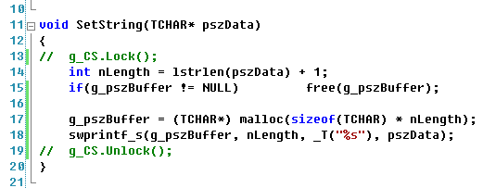
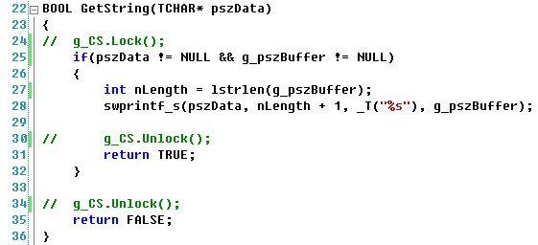
Critical section
ThreadFunc1(), ThreadFunc2()
1
4
Main Thread – “Call GetString()”
2
3

Slide 31
Critical section
10
11 void SetString(TCHAR* pszData)
12 {
13 g_CS.Lock( );
14 int nLength = lstrlen(pszData) + 1;
15 if(g_pszBuffer != NULL) free(g_pszBuffer);
16
17 g_pszBuffer = (TCHAR*) malloc(sizeof(TCHAR) * nLength);
18 swprintf_s(g_pszBuffer, nLength, _T("%s"), pszData);
19 g_CS.Unlock( );
20 }
21

Slide 32
Semaphore
CSemaphore(
LONG lInitialCount = 1,
LONG lMaxCount = 1,
LPCTSTR pstrName = NULL,
LPSECURITY_ATTRIBUTES lpsaAttributes = NULL
);

Slide 33
Semaphore
184
185 UINT CSemaphoreDemoApp::ThreadSemaphore(LPVOID pParam)
186 {
187 CString strTmp = _T("");
188 int nIndex = (int)(pParam);
189
190 g_arString[nIndex] = _T("");
191 while(::WaitForSingleObject(theApp.m_ExitEvent, 10) == WAIT_TIMEOUT)
192 {
193 g_arString[nIndex].Format(_T("%dth Thread is waiting! "), nIndex);
194
195 g_SP.Lock( );
196 g_arString[nIndex].Format(_T("##%d Thread is running!##"), nIndex);
197 ::Sleep(100);
198 g_SP.Unlock( );
199 }
200
201 return 0;
202 }
203

Slide 34
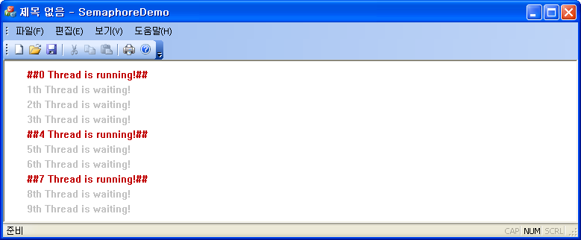
Semaphore
99 AddDocTemplate(pDocTemplate);
100
101 for(int i = 0; i < 10; ++i)
102 {
103 AfxBeginThread(CSemaphoreDemoApp::ThreadSemaphore, (LPVOID)i);
104 }
105
106 // 표준 셸 명령, DDE, 파일 열기에 대한 명령줄을 구문 분석합니다.
107 CCommandLineInfo cmdInfo;
108 ParseCommandLine(cmdInfo);
109

Slide 35
Updater
CEvent(
BOOL bInitiallyOwn = FALSE,
BOOL bManualReset = FALSE,
LPCTSTR lpszName = NULL,
LPSECURITY_ATTRIBUTES lpsaAttribute = NULL
);
29
30 // CUpdateDemoApp 생성
31
32 CUpdateDemoApp::CUpdateDemoApp( )
33 :m_ExitEvent(FALSE, TRUE),
34 m_UpdateEvent(FALSE, TRUE, _T("UPDATE_TEST_EVENT"))
35 {
36
37 m_bHiColorIcons = TRUE;
38

Slide 36
Updater
186
187 UINT CUpdateDemoApp::ThreadUpdate(LPVOID pParam)
188 {
189 HANDLE arhList[2];
190 arhList[0] = theApp.m_ExitEvent;
191 arhList[1] = theApp.m_UpdateEvent;
192
193 DWORD dwResult = ::WaitForMultipleObjects(2, arhList, FALSE, INFINITE);
194 if(dwResult == WAIT_OBJECT_0 + 1)
195 {
196 CWnd* pMain = theApp.m_pMainWnd;
197 if(pMain != NULL) pMain->PostMessage(WM_CLOSE);
198 }
199
200 return 0;
201 }
202

Slide 37
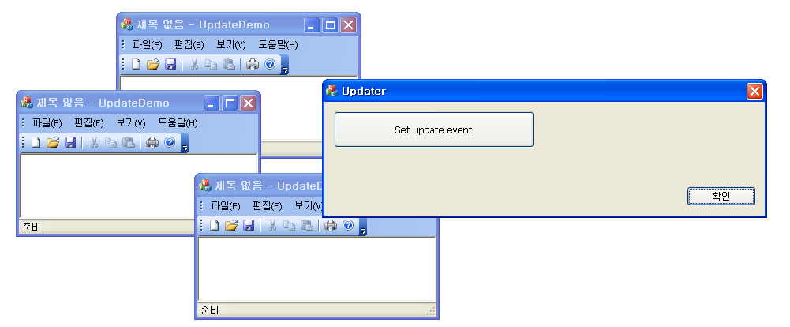
Updater
155
156 void CUpdaterDlg::OnBnClickedButtonSetupdateevent( )
157 {
158 CEvent UpdateEvent(FALSE, TRUE, _T("UPDATE_TEST_EVENT"));
159 UpdateEvent.SetEvent( );
160 ::Sleep(500);
161 }
162

Slide 38
DuplicationCheck
45
46 // CDuplicationCheckApp 초기화
47
48 BOOL CDuplicationCheckApp::InitInstance( )
49 {
50 m_hDupCheck = ::CreateEvent(NULL, FALSE, FALSE, _T("DUPLICATION_CHECK_EVENT"));
51 if(::GetLastError( ) == ERROR_ALREADY_EXISTS)
52 {
53 AfxMessageBox(_T("ERROR: Application is running!"));
54 return FALSE;
55 }
56
190
191 int CDuplicationCheckApp::ExitInstance( )
192 {
193 if(m_hDupCheck != NULL) ::CloseHandle(m_hDupCheck);
194
195 return CWinAppEx::ExitInstance( );
196 }
197

Slide 39
Chapter 31
  Inter Process Communication

Slide 40
Inter Process Commnucation
SharedMemDemo #1
0x00000000
Mapping
0xFFFFFFFF
0x00EC0000
4GB (VMS)Virtual Memory Space
1
User mode memory
Kernel mode memory
SharedMemDemo #2
Shared memory
0x00000000
Mapping
0xFFFFFFFF
0x00EC0000
4GB (VMS)Virtual Memory Space
2
User mode memory
Kernel mode memory

Slide 41
Inter Process Commnucation
17
18 class CSharedMemDemoApp : public CWinAppEx
19 {
20 public:
21 CSharedMemDemoApp();
22
23 HANDLE m_hMap;
24 TCHAR* m_pSharedMemory;
25 CMutex m_Mutex;
26
27 CEvent m_ExitEvent;
28 CEvent m_ReadEvent;
29
22
23 CSharedMemDemoApp::CSharedMemDemoApp()
24 :m_Mutex(FALSE, TEXT("IPC_TEST_MUTEX")),
25 m_ExitEvent(FALSE, TRUE),
26 m_ReadEvent(FALSE, TRUE, _T("IPC_READ_SHAREDMEMORY"))
27 {
28 m_hMap = NULL;
29 m_pSharedMemory = NULL;
30 }
31

Slide 42
Inter Process Commnucation
86
87 BOOL CSharedMemDemoApp::InitSharedMemory(void)
88 {
89 m_hMap = ::CreateFileMapping(INVALID_HANDLE_VALUE,
90 NULL,
91 PAGE_READWRITE,
92 0,
93 sizeof(TCHAR) * 128,
94 _T("IPC_TEST_SHARED_MEMORY"));
95 if(::GetLastError( ) == ERROR_ALREADY_EXISTS)
96 {
97 m_hMap = ::OpenFileMapping(FILE_MAP_ALL_ACCESS, FALSE,
98 _T("IPC_TEST_SHARED_MEMORY"));
99 }
100
101 if(m_hMap == NULL)
102 {
103 AfxMessageBox(_T("ERROR: Failed to create(open) file mapping object!"));
104 return FALSE;
105 }
106

Slide 43
Inter Process Commnucation
106
107 m_pSharedMemory = (TCHAR*)::MapViewOfFile(m_hMap,
108 FILE_MAP_ALL_ACCESS,
109 0,
110 0,
111 sizeof(TCHAR) * 128);
112 if(m_pSharedMemory == NULL)
113 {
114 AfxMessageBox(_T("ERROR: Failed to get shared memory!"));
115 return FALSE;
116 }
117
118 return TRUE;
119 }
120

Slide 44
Inter Process Commnucation
HANDLE CreateFileMapping(
HANDLE hFile,
LPSECURITY_ATTRIBUTES lpFileMappingAttributes,
DWORD flProtect,
DWORD dwMaximumSizeHigh,
DWORD dwMaximumSizeLow,
LPCTSTR lpName
);
LPVOID MapViewOfFile(
HANDLE hFileMappingObject,
DWORD dwDesiredAccess,
DWORD dwFileOffsetHigh,
DWORD dwFileOffsetLow,
DWORD dwNumberOfBytesToMap
);

Slide 45
Inter Process Commnucation
120
121 int CSharedMemDemoApp::ExitInstance( )
122 {
123 if(m_pSharedMemory != NULL) :UnmapViewOfFile(m_pSharedMemory);
124 if(m_hMap != NULL) ::CloseHandle(m_hMap);
125
126 m_ExitEvent.SetEvent( );
127 ::Sleep(100);
128
129 return CWinAppEx::ExitInstance( );
130 }
131

Slide 46
Inter Process Commnucation
64
65 if(!InitSharedMemory( )) return FALSE;
66 AfxBeginThread(CSharedMemDemoApp::ThreadReadSharedMemory, NULL);
67

Slide 47
Inter Process Commnucation
132 UINT CSharedMemDemoApp::ThreadReadSharedMemory(LPVOID pParam)
133 {
134 DWORD dwResult = WAIT_OBJECT_0 + 1;
135 HANDLE arhList[2];
136 arhList[0] = theApp.m_ExitEvent;
137 arhList[1] = theApp.m_ReadEvent;
138
139 while(dwResult == WAIT_OBJECT_0 + 1)
140 {
141 dwResult = ::WaitForMultipleObjects(2, arhList, FALSE, INFINITE);
142 if(dwResult == WAIT_OBJECT_0)
143 {
144 break;
145 }
146 else if(dwResult == WAIT_OBJECT_0 + 1)
147 {
148 theApp.m_pMainWnd->PostMessage(UM_RECV_EVENT);
149 ::Sleep(10);
150 }
151 }
152
153 return 0;
154 }

Slide 48
Inter Process Commnucation
163
164 LRESULT CSharedMemDemoDlg::OnRecvEvent(WPARAM wParam, LPARAM lParam)
165 {
166 m_List.InsertString(0, theApp.m_pSharedMemory);
167 return 0;
168 }
169

Slide 49
Inter Process Commnucation
169
170 void CSharedMemDemoDlg::OnBnClickedButtonSend( )
171 {
172 if(!UpdateData(TRUE) || m_csMessage.GetLength( ) <= 0)
173 return;
174
175 if(theApp.m_Mutex.Lock(1000))
176 {
177 CEvent EventSend(FALSE, TRUE, TEXT("IPC_READ_SHAREDMEMORY"));
178 wsprintf(theApp.m_pSharedMemory, _T("%s"), m_csMessage);
179
180 EventSend.SetEvent( );
181 ::Sleep(1);
182 EventSend.ResetEvent( );
183 theApp.m_Mutex.Unlock( );
184 }
185 else

Slide 50
Inter Process Commnucation
183 theApp.m_Mutex.Unlock( );
184 }
185 else
186 {
187 AfxMessageBox(_T("ERROR: Lock( ) return FALSE!"));
188 return;
189 }
190
191 m_csMessage = _T("");
192 UpdateData(FALSE);
193 }
194

Slide 51
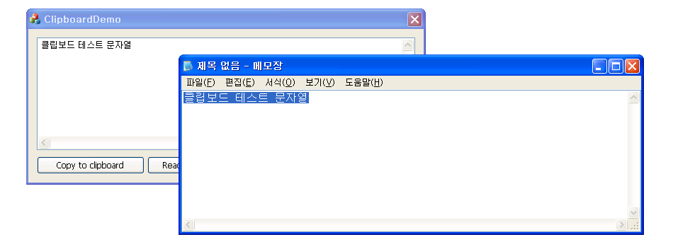
ClipboardDemo

Slide 52
ClipboardDemo
159 void CClipboardDemoDlg::OnBnClickedButtoCopytoclipboard( )
160 {
161 UpdateData(TRUE);
162 if(m_strText.GetLength( ) <= 0) return;
163
164 HGLOBAL hGlobalMemory;
165 TCHAR* pszBuffer = NULL;
166
167 if(::OpenClipboard(m_hWnd) == FALSE)
168 {
169 AfxMessageBox(_T("ERROR: Failed to open clipboard"));
170 return;
171 }
172
173 int nLength = (m_strText.GetLength( ) + 1) * sizeof(TCHAR);
174 hGlobalMemory = ::GlobalAlloc(GMEM_MOVEABLE | GMEM_ZEROINIT, nLength);
175 if(hGlobalMemory == NULL)
176 {
177 AfxMessageBox(_T("ERROR: Failed to allocate global memory!"));
178 ::CloseClipboard( );
179
180 return;
181 }

Slide 53
ClipboardDemo
182
183 pszBuffer = (TCHAR*)::GlobalLock(hGlobalMemory);
184 wsprintf(pszBuffer, _T("%s"), m_strText);
185 ::GlobalUnlock(hGlobalMemory);
186
187 ::EmptyClipboard( );
188 ::SetClipboardData(CF_UNICODETEXT, hGlobalMemory);
189 ::CloseClipboard( );
190
191 }
192

Slide 54
ClipboardDemo
192
193 void CClipboardDemoDlg::OnBnClickedButtoReadfromclipboard( )
194 {
195 if(!::IsClipboardFormatAvailable(CF_UNICODETEXT)) return;
196 if(!::OpenClipboard(m_hWnd)) return;
197
198 HGLOBAL hGlobalMemory = ::GetClipboardData(CF_UNICODETEXT);
199 if(hGlobalMemory != NULL)
200 {
201 TCHAR* pszBuffer = (TCHAR*)::GlobalLock(hGlobalMemory);
202 if(pszBuffer != NULL)
203 {
204 m_strText.Format(_T("%s"), pszBuffer);
205 ::GlobalUnlock(hGlobalMemory);
206 }
207 }
208
209 ::CloseClipboard( );
210 UpdateData(FALSE);
211 }
212

Slide 55
Chapter 32
  Dynamic Linking Library

Slide 56
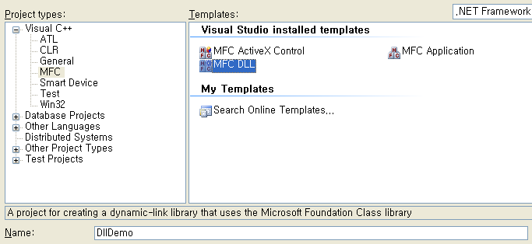
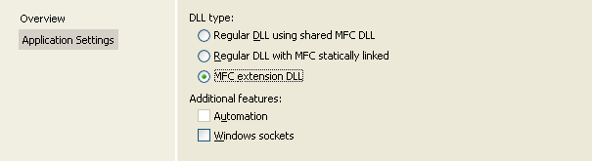
Dynamic Linking Library

Slide 57
Dynamic Linking Library
13
14 extern "C" int APIENTRY
15 DllMain(HINSTANCE hInstance, DWORD dwReason, LPVOID lpReserved)
16 {
17 // Remove this if you use lpReserved
18 UNREFERENCED_PARAMETER(lpReserved);
19
20 if (dwReason == DLL_PROCESS_ATTACH)
21 {
22 TRACE0("DllDemo.DLL Initializing!\n");
23
24 // Extension DLL one-time initialization
25 if (!AfxInitExtensionModule(DllDemoDLL, hInstance))
26 return 0;
27
28 new CDynLinkLibrary(DllDemoDLL);
29
30 }

Slide 58
Dynamic Linking Library
29
30 }
31 else if (dwReason == DLL_PROCESS_DETACH)
32 {
33 TRACE0("DllDemo.DLL Terminating!\n");
34
35 // Terminate the library before destructors are called
36 AfxTermExtensionModule(DllDemoDLL);
37 }
38 return 1; // ok
39 }
40

Slide 59
Dynamic Linking Library
41 __declspec(dllexport)
42 BOOL WINAPI GetModulePath(CString& strPath)
43 {
44 TCHAR szBuffer[MAX_PATH];
45 ::ZeroMemory(szBuffer, sizeof(szBuffer));
46 ::GetModuleFileName(NULL, szBuffer, MAX_PATH);
47
48 for(int i = lstrlen(szBuffer) - 1; i >= 0; --i)
49 {
50 if(szBuffer[i] == '\\')
51 {
52 int j = lstrlen(szBuffer) - 1;
53 for(; j >= i; --j)
54 {
55 szBuffer[j] = NULL;
56 }
57
58 if(szBuffer[j] == ':') szBuffer[j + 1] = '\\';
59
60 strPath = szBuffer;
61 return TRUE;
62 }
63 }
64
65 return FALSE;
66 }

Slide 60
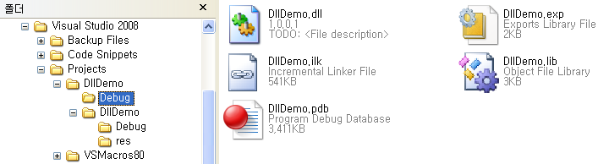
Dynamic Linking Library

Slide 61
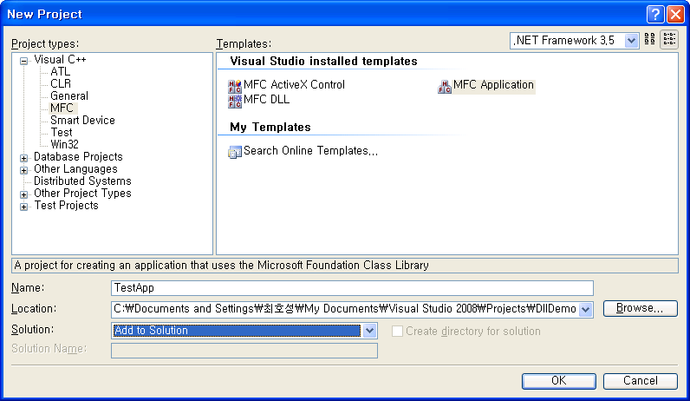
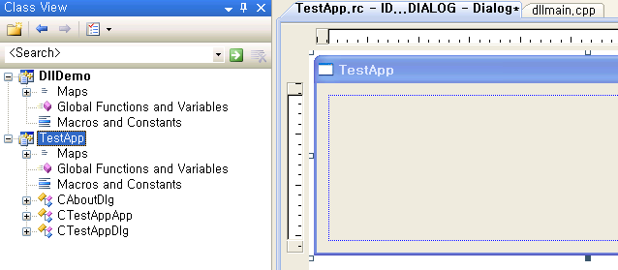
Dynamic Linking Library
37
38 #include <afxcontrolbars.h>
39
40 __declspec(dllimport) BOOL WINAPI GetModulePath(CString& strPath);
41 #pragma comment(lib, "DllDemo")
42

Slide 62
Dynamic Linking Library
155
156 void CTestAppDlg::OnBnClickedButtonGetpath( )
157 {
158 CString strPath = _T("");
159 if(::GetModulePath(strPath))
160 {
161 AfxMessageBox(strPath);
162 }
163 }
164

Slide 63
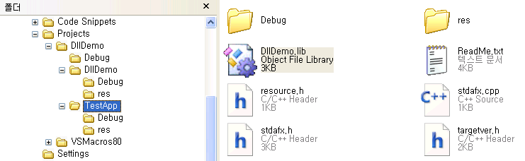
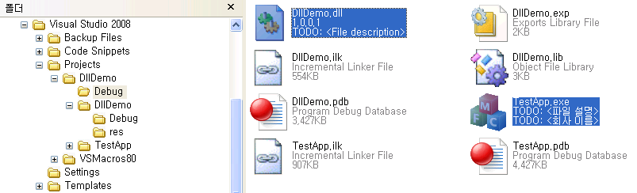
Dynamic Linking Library

Slide 64
Dynamic Linking Library - Explicit
155
156 void CTestAppDynDlg::OnBnClickedButtonGetpath( )
157 {
158 HMODULE hModule = ::LoadLibrary(_T("DllDemo.dll"));
159 if(hModule != NULL)
160 {
161 CString strTmp = _T("");
162 BOOL (WINAPI* pfnGetModulePath)(CString&) = NULL;
163 pfnGetModulePath = (BOOL (WINAPI*)(CString&))::GetProcAddress(hModule, "GetModulePath");
164 if(pfnGetModulePath != NULL)
165 {
166 if(pfnGetModulePath(strTmp)) AfxMessageBox(strTmp);
167 }
168 else
169 {
170 AfxMessageBox(_T("ERROR: Failed to get function address!"));
171 }
172
173 ::FreeLibrary(hModule);
174 }
175 }

Slide 65
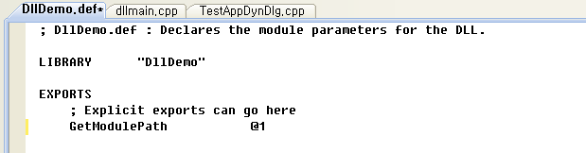
Dynamic Linking Library
41 BOOL WINAPI GetModulePath(CString& strPath)
2 {
3 TCHAR szBuffer[MAX_PATH];
4 ::ZeroMemory(szBuffer, sizeof(szBuffer));
5 ::GetModuleFileName(NULL, szBuffer, MAX_PATH);

Slide 66
Dynamic Linking Library
묵시적, 명시적 연결이 모두 가능하도록 라이브러리를 개발한다.
함수의 원형 선언과 LIB 파일을 인클루드(Include)하는 #pragma 선언을 별도의 헤더 파일로 만든다.
  1 //DllDemo.DLL Header file.
  2
  3 #pragma once
  4
  5 BOOL WINAPI GetModulePath(CString& strPath);
  6 #pragma comment(lib, "DllDemo")
라이브러리 활용에 필요한 최소한의 도움말과 예제를 작성한다.
디버그, 릴리즈 모드 라이브러리를 모두 빌드하여 전달한다.
  1 //DllDemo.dll header file
  2 #pragma once
  3
  4 BOOL WINAPI GetModulePath(CString& strPath);
  5
  6 #ifdef _DEBUG
  7 #pragma comment(lib, "DllDemoD")
  8 #else
  9 #pragma comment(lib, "DllDemo")
  10 #endif

